Slide 1
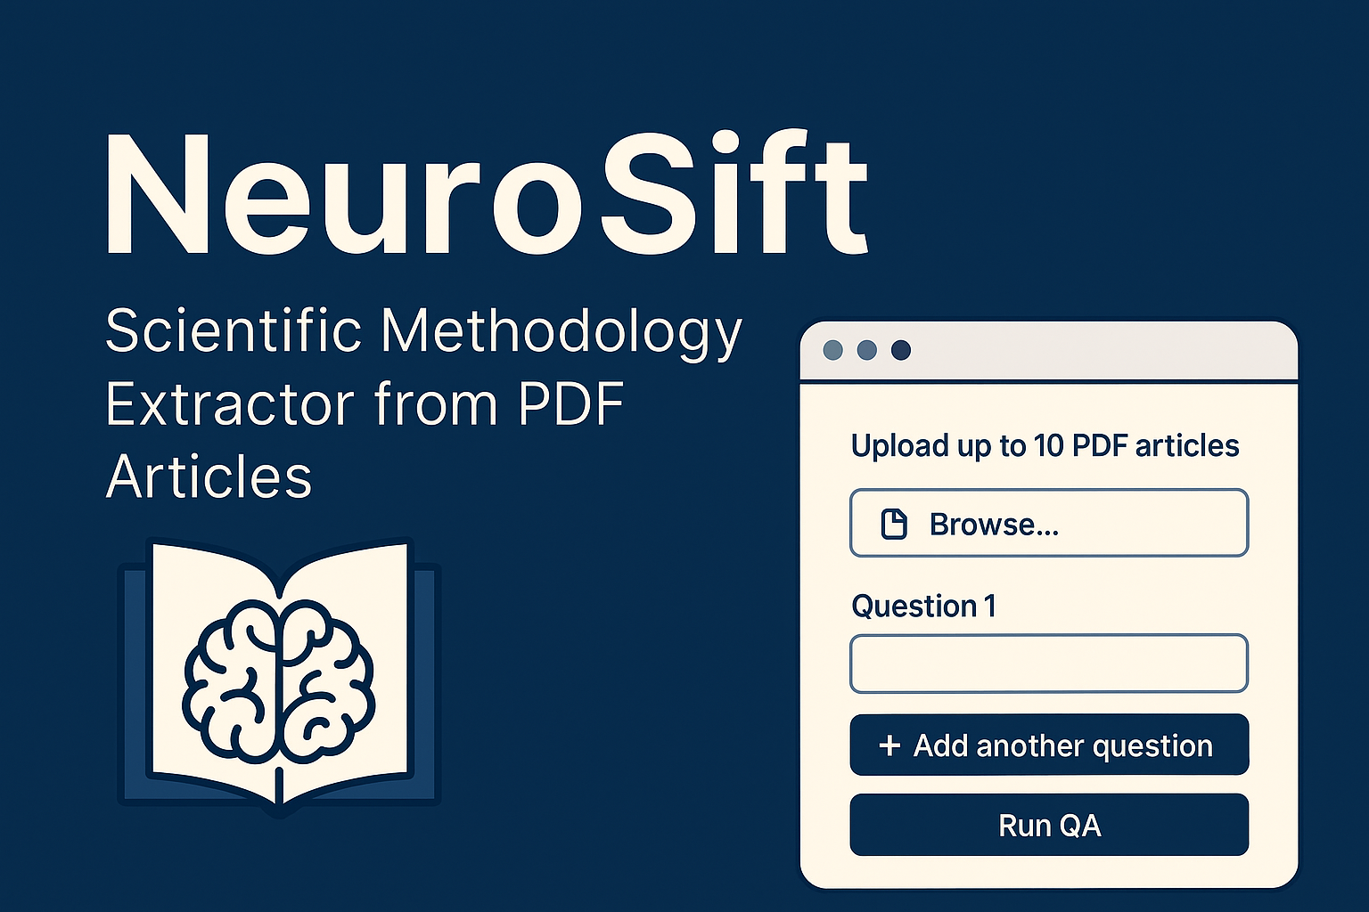
Vaishali Vinod
From LLMs to AI agents – Project presentation

Slide 2
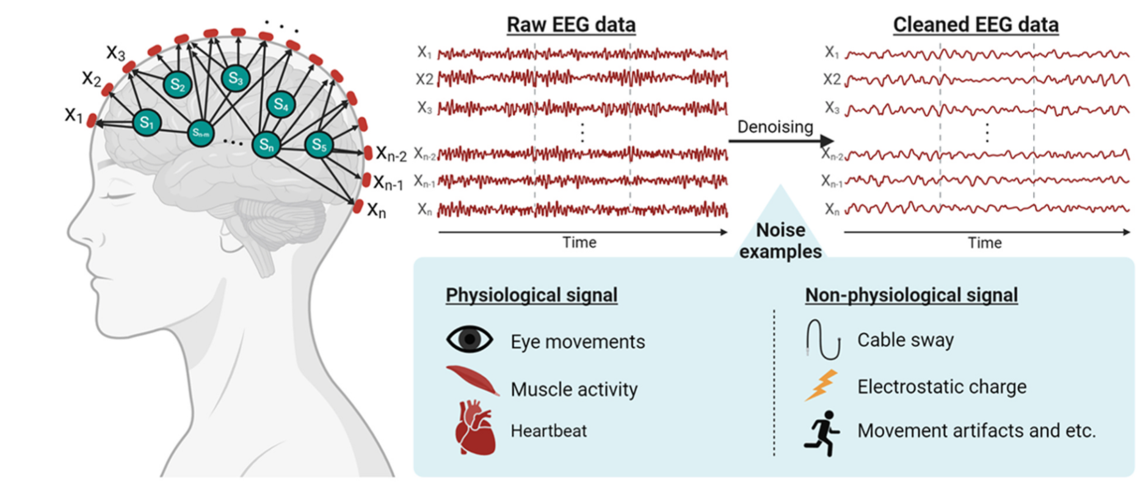
Preprocessing in EEG data
Preprocessing is a crucial step in analysing EEG data as the raw data usually contain a lot of noise and artifacts
Richer ea., Neurosci Biobehav Rev. 2024

Slide 3
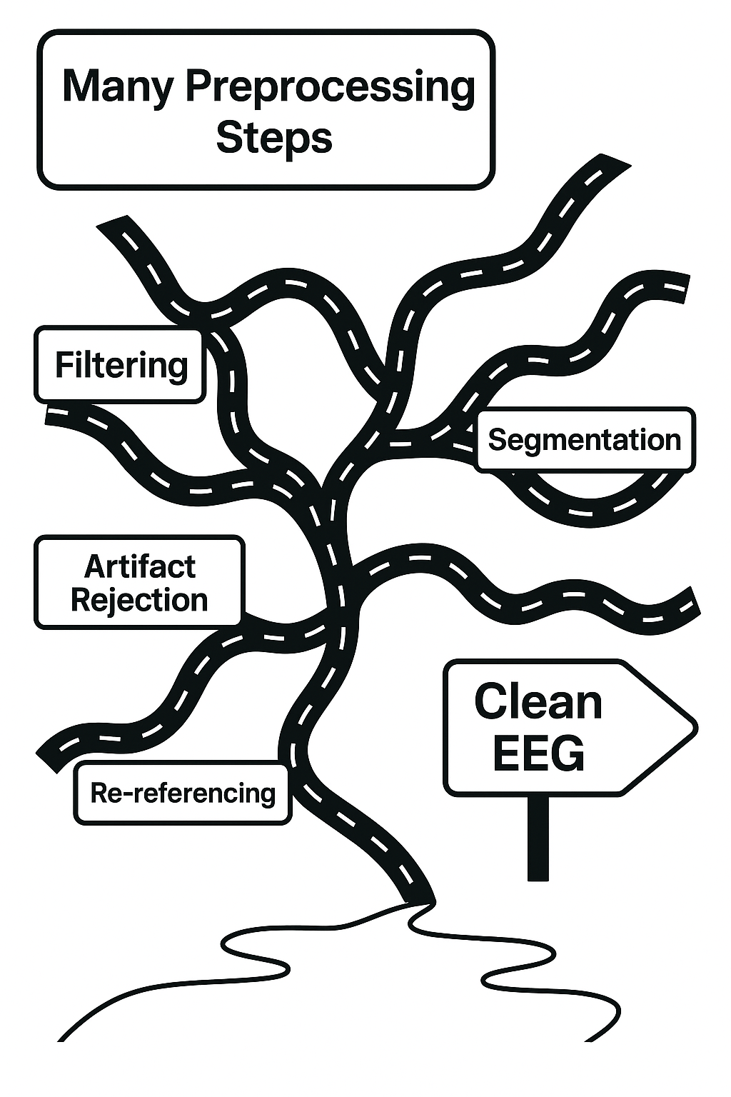
The road to a clean EEG data is not straight forward as there are many different pipelines differing from each dataset

Slide 4
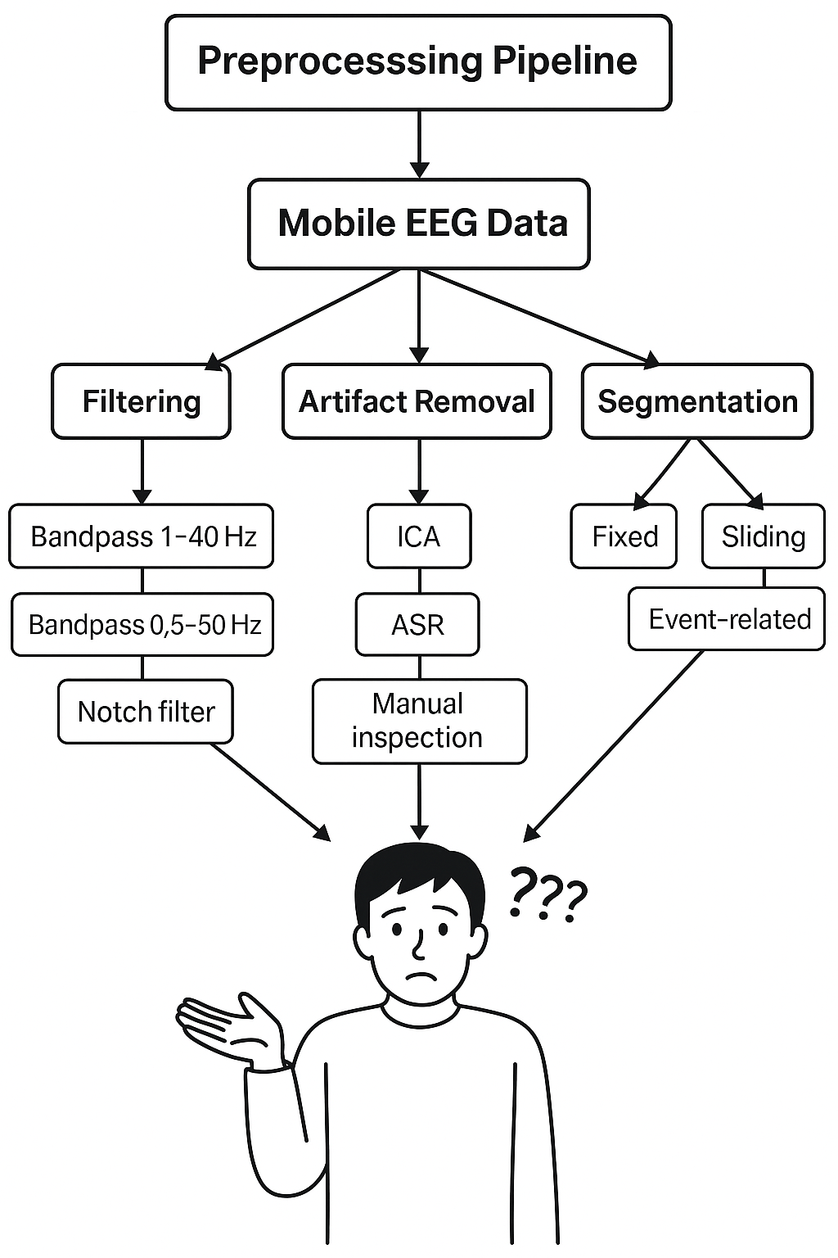
The preprocessing pipeline can influence the outcome significantly and hence researchers have to decide on an optimum pipeline for a specific dataset and research question

Slide 5
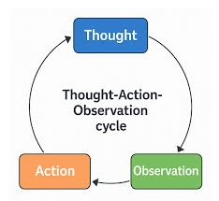
NeuroSift
AI Agent that can scan, parse and extract structured methods pipelines from neurological literature
Particularly in EEG studies
Built using the AI Agent paradigm
Task: “Find and summarize EEG preprocessing pipelines from articles on visual oddball paradigms.”

Slide 6
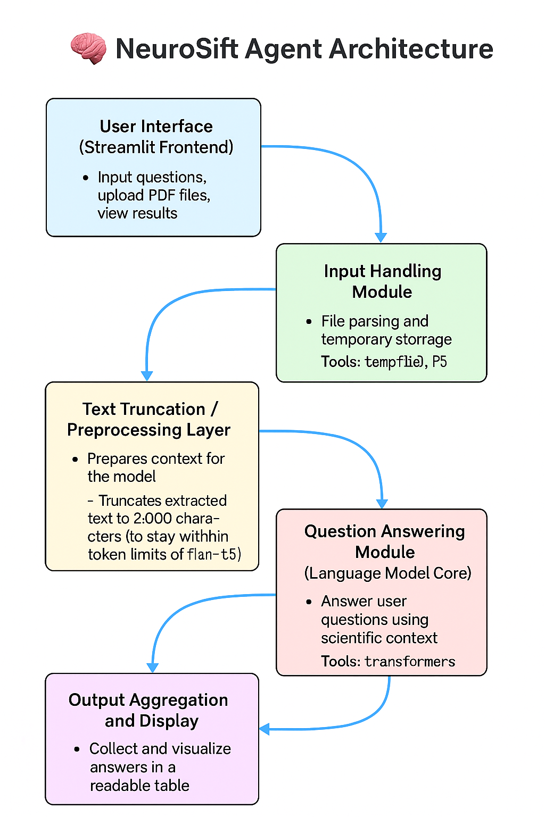
Agent architecture

Slide 7
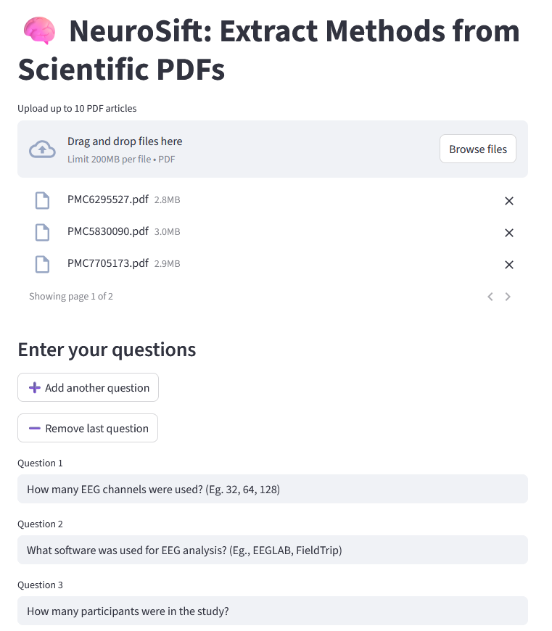
User Interface

Slide 8
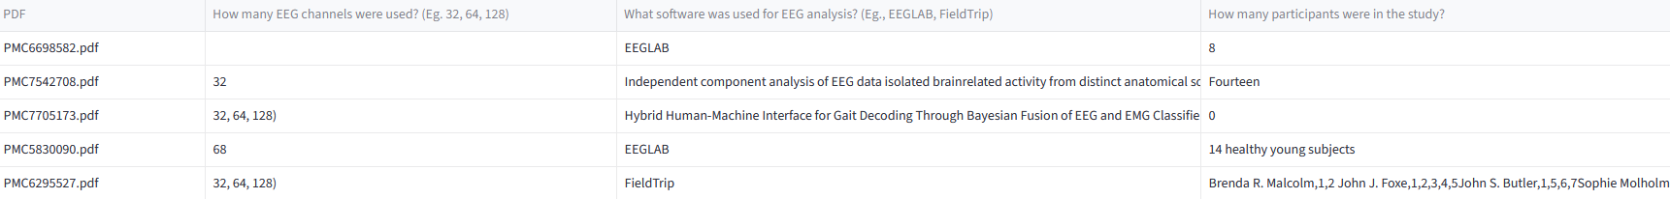
Example output

Slide 9
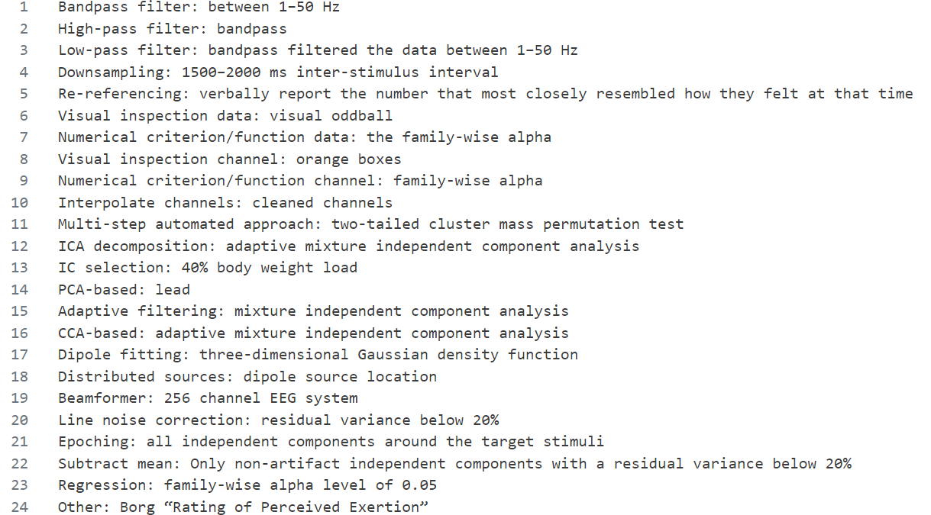
Extracting more parameters

Slide 10
Progress so far
Able to successfully extract and parse papers of interest
Not successful in identifying the ideal LLM for this purpose
Need to fine-tune model specifically for EEG literature
Errors mainly due to:
Missing methods sections
Ambiguous writing styles

Slide 11
Links
GH repo: https://github.com/vaishalivinod/NeuroSift_LLMCourse_OC
Streamlit app: https://neurosift-cm9aoznzchtpwqv2n7zfbs.streamlit.app/

